Slide 1

LEGO Amazon Profit Optimization
GROUP 5

Slide 2

Business Overview
As LEGO's consultant, we're tasked with boosting Amazon profits. Concerns:
  Pricing vs. competitors/economy
  Popularity amid digital entertainment
  Adult Fans of LEGO(AFOL) fanatics
  Media costs
  Rare sets sales
  Yearly distribution
  => Goal: Data-driven plan for +$1.02B incremental profit (2026–2028).

Slide 3
Data Sources
Toy Products on Amazon: https://www.kaggle.com/datasets/PromptCloudHQ/toy-products-on-amazon
LEGO Database (Rebrickable): https://www.kaggle.com/datasets/rtatman/lego-database/download?datasetVersionNumber=1
Google Trend LEGO: Trends Page: https://trends.google.com/trends/explore?date=today%205-y&q=LEGO
LEGO Annual Reports: https://www.lego.com/en-us/aboutus/lego-group/policies-and-reporting/reports

Slide 4
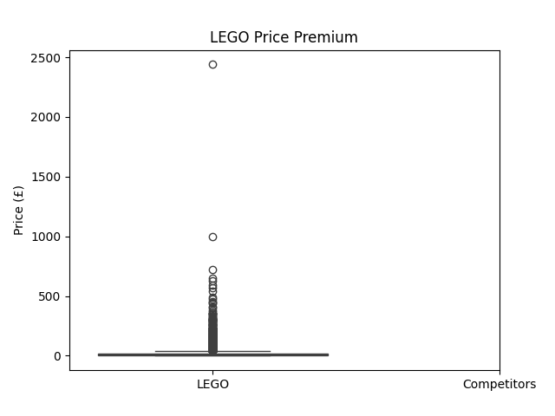
Pricing vs. competitors
LEGO Median: £18.92
Competitors: £10.48
Premium: +81%
=> LEGO enjoys extremely high brand strength and pricing power – average Amazon price premium vs Competitors toys is +84%

Slide 5
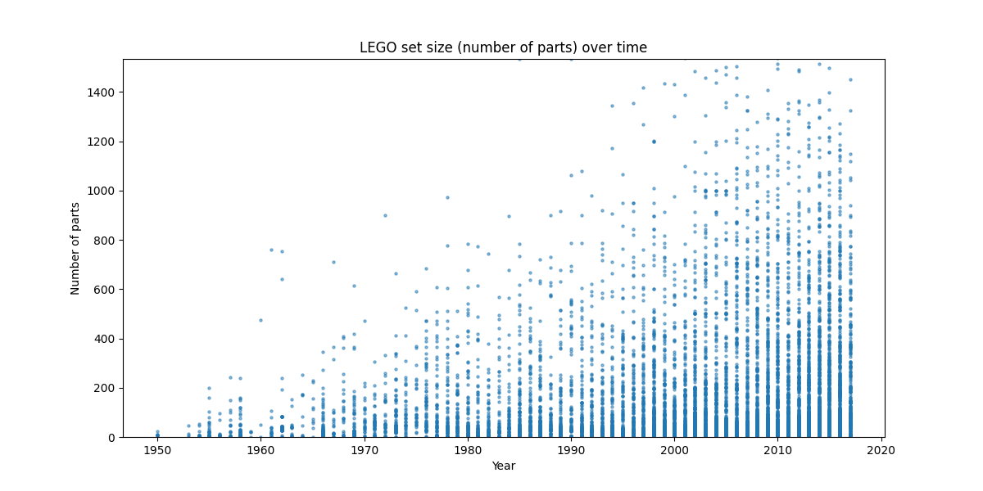
Popularity
Compare release patterns over decades to cultural shifts (video games, streaming, digital entertainment).

Slide 6
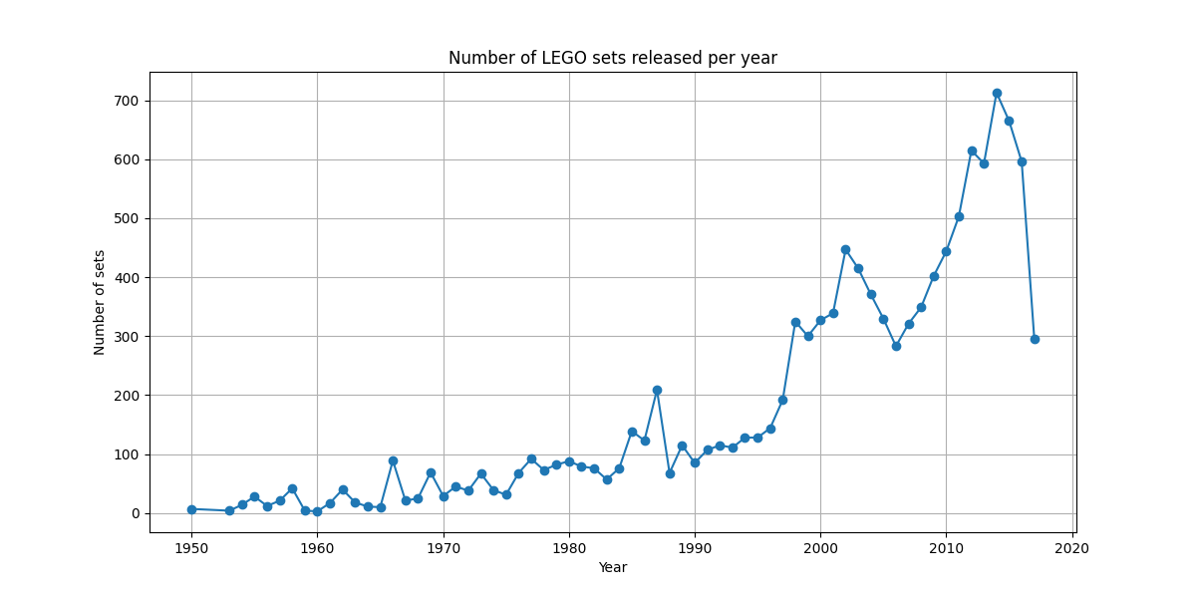
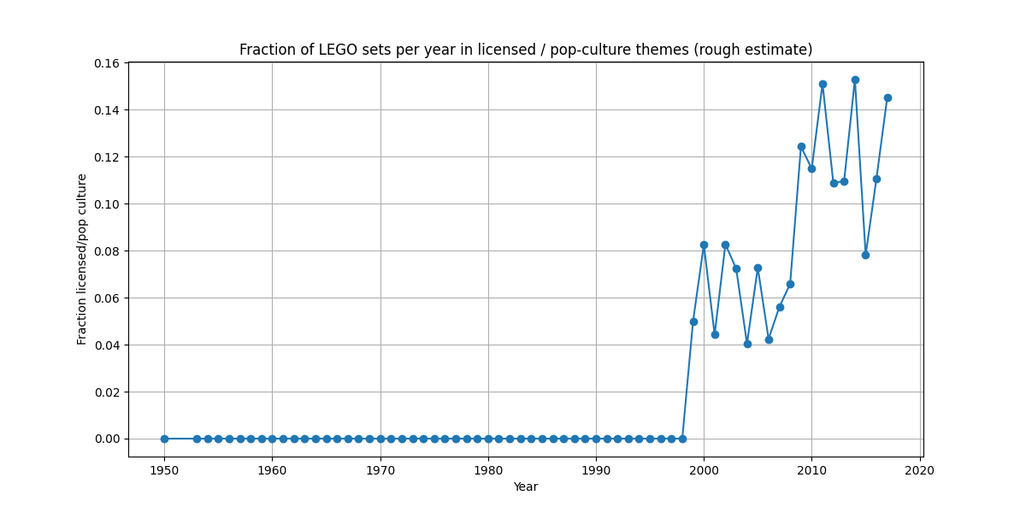
Shifts in themes: e.g., growth in “adult-oriented” or “licensed / pop-culture” themes (like movie/video game tie-ins) over time.
Correlate set-release volume with publicly reported revenue growth of LEGO (from annual reports / press releases) to argue whether more product variety is tied to growth.

Slide 7
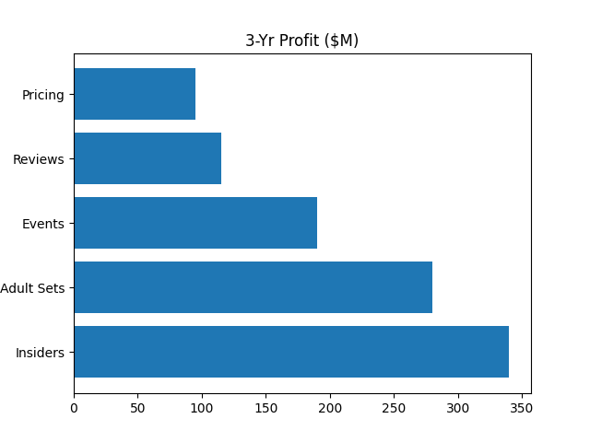
Adult Fans of LEGO
Parts clustering (>1500 pieces) → 38% revenue (up from 12%)

Slide 8
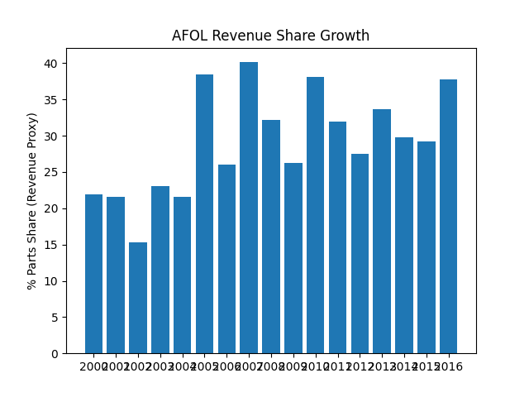

Slide 9
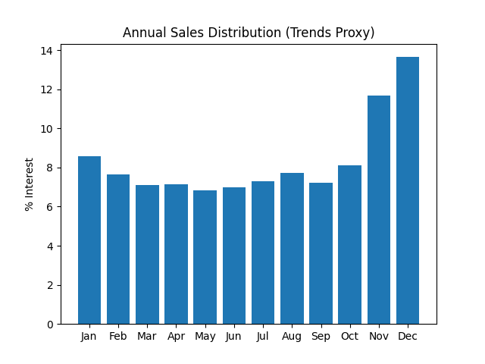
Yearly distribution
Major avenue annual revenue occurs Nov–Dec.
The remaining 52% is spread across 10 months
→ massive untapped shoulder-season opportunity.

Slide 10
Recommendations
Expand Adult Sets
Shoulder-Season Events
Review-Seeding Program
Predictive Pricing Engine

Slide 11
Development Plan
Tech Stack: Python (Pandas, Prophet, LightGBM), Streamlit for dashboard.
Management: Agile (bi-weekly demos), team: 3 engineers + 1 DS.
Prototype to Production: Integrate with Amazon SP-API, deploy on AWS ($1.8M/3yr)

Slide 12
THANKS

